Slide 1
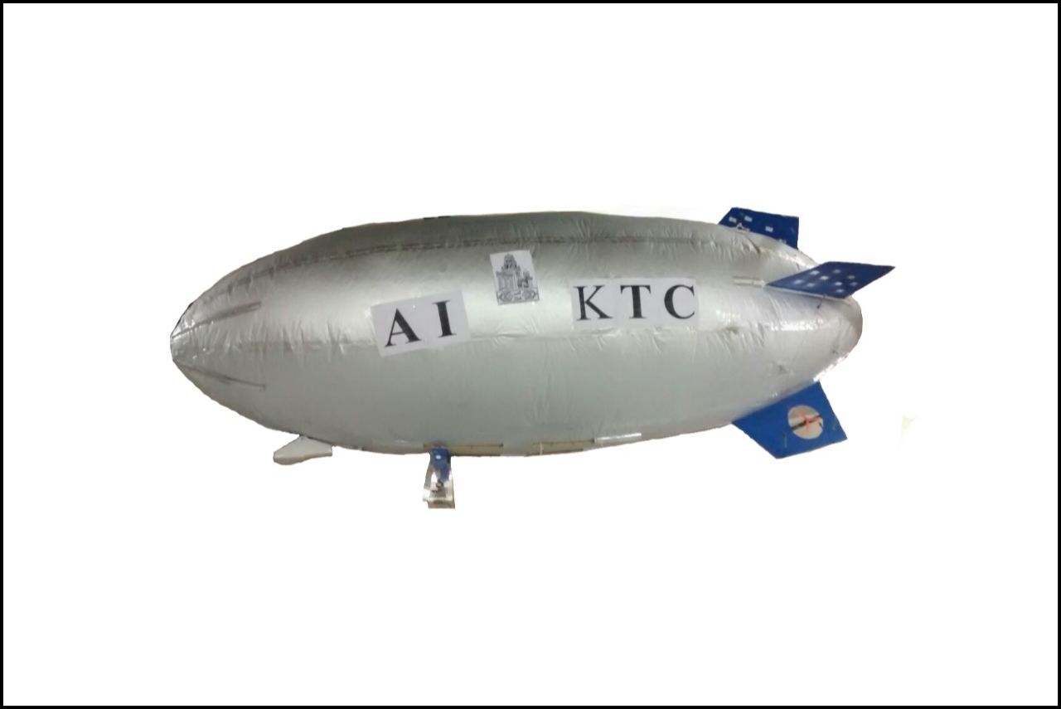
“DESIGN AND DEVELOPMENT OF AN INDOOR AIRSHIP”
{GONDOLA (FIXED & SLIDING), AVIONICS, NOSE BATTEN}
AIKTC-School OF Engineering & Technology
Teams
Shaikh Faisal Abdul Qayyum
Arfat Ziyauddin Inamdar
Sayyed Mufeed Fidae Abbas
Javed Abdul Saleem
Guide : Prof. Nawaz I. Motiwala

Slide 2
Overview
History and Introduction
Components of an airship
Motivation
Aim and objectives
Literature Review
Problem definition
Gondola
Nose battens
Mooring Mast
Result
Flight Testing
Conclusion
References

Slide 3
History
In 1852, Henri Giffard made Steam engine powered airship^{[1]}.
In 1872, Paul Haenlein flew an airship with an IC engine running on the coal gas .
In 1936-1937, The largest passenger airship is made by Germany named as Zeppelin airship.
Fig1 : Giffard airship^{[1]}

Slide 4
Introduction
An Airship is lighter-than-air vehicle with propulsion and steering system and It obtains its buoyancy from lighter than air gas such as H(Hydrogen), He(Helium), Hot Air etc based on Archimedes Principle.
Airship is categorized in following types
Non Rigid Airship
Semi Rigid Airship
Rigid Airship

Slide 5
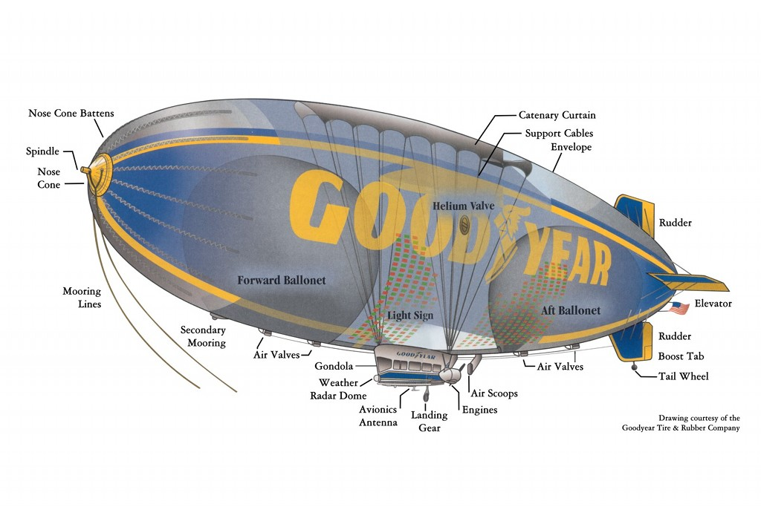
Components of an airship
Fig2: components of airship^{[2]}

Slide 6
Motivation
A seminar was arranged by Mechanical Engineering department For final year students regarding final year project which was conducted by Prof. R S Pant (IIT BOMBAY) which inspire us for selecting our final year project as indoor airship because.
The uses of Application of Airships has rise tremendously over past years
More Scope for Development, many projects are going on worldwide
Eliminates the limitation of heavier than air system.

Slide 7
Indoor(Non Rigid) Airship
The Part for design and developing of Indoor Airship are as given below.
Gondola Structure
Avionics
Nose batten

Slide 8
Aim
Design and fabrication of gondola and nose batten along with its attachments
Objectives
It should be light in weight
It should be strong
Easy to attach or removal with envelope
Offers negligible drag
Nose battens should be light in weight and avoid damage to envelope
Controlling range is up to 1km.

Slide 9
Literature Survey
Very few researches have been carried out in the area of design of airships. And papers are being published.
Three remotely controlled airship was made at IIT-Bombay during research is carried out as shown below.
Fig 3: Micro Airship ^{[5]} Fig 4: Mini Airship ^{[5]} Fig 5: Macro Airship ^{[4]}

Slide 10
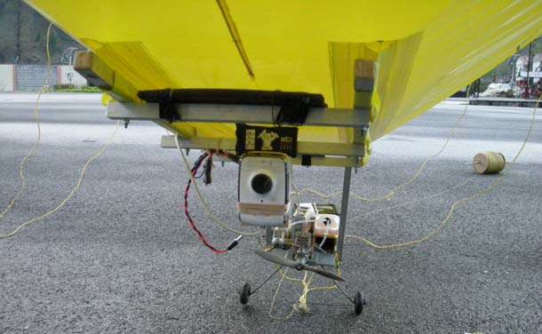
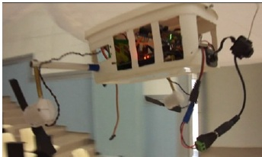
Literature Survey (Contd..)
Two types of gondola were made during researches as shown below.
Open structure type gondola
Closed structure type gondola
Fig 6: Open Gondola of macro airship ^{[4]} Fig 7:Closed gondola of indoor airship ^{[5]}

Slide 11
Problem definition
To design and fabricate gondola by selecting light and strong material
To maintain the C.G of airship with sliding gondola mechanism.

Slide 12
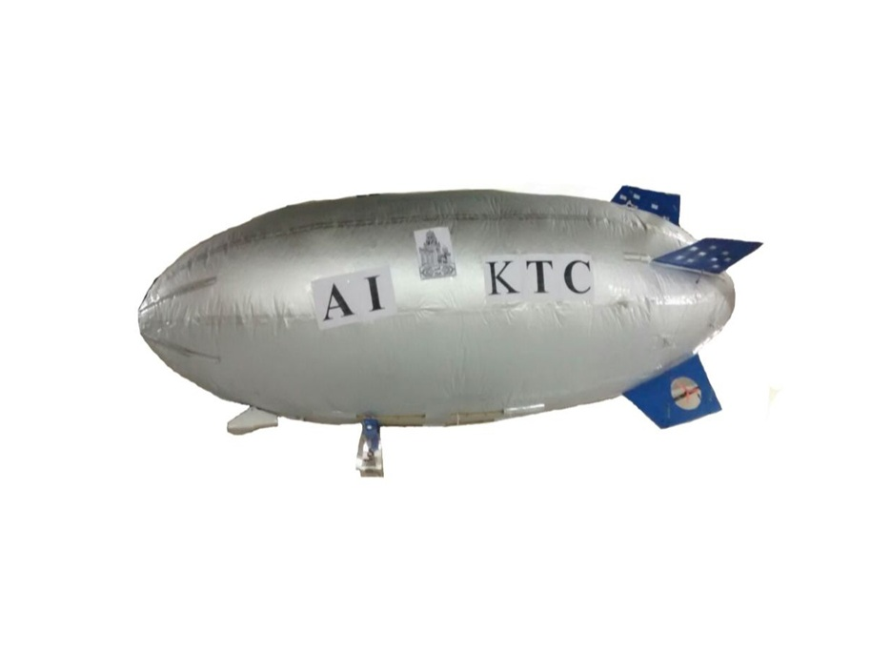
Methodology
Analysis
Selection of material
Design
Determination of forces
Drawing
Inspection
Modification
Fabrication
Fig 8 : Methodology

Slide 13
Identification of Material
1.Thermoplastics and Metals
parameter | Carbon fibre | Light density polyethylene | Acrylic sheet | Aluminium
Density | 1750kg/m³ | 950kg/m³ | 1190kg/m³ | 2700 kg/m³
strength | 3.5Gpa | 25Mpa | 65Mpa | 100-350Mpa
Cost | Rs.1000-1200 | Rs.300-350 | Rs.103 | Rs.115
Size | 300*100*1.5mm | 305*305*2.2mm | 297*210*2 | 1kg
Reference | http://goo.gl/jO9Eu0 | http://goo.gl/nSuaSM | http://goo.gl/PGOyB9 | http://goo.gl/gFLH5

Slide 14
Identification of Material
2.Woods
Comparison between balsa wood and Bamboo
Parameter | Bamboo | Balsa wood
Density | 350kg/m³ | 150kg/m³
Strength | 16Mpa | 19.9Mpa
Cost | - | Rs90-100
Size | - | 100*100*2mm
Reference | http://goo.gl/zje2fl | http://goo.gl/3sdY2E

Slide 15
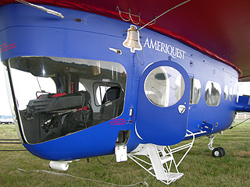
Gondola
An aerodynamically shaped vessel.
Holds and protects all the hardware in the airship.
Equipped with two or three dc motors to control the motion of airship.
Fig9 : Gondola of an airship^{[6]}

Slide 16
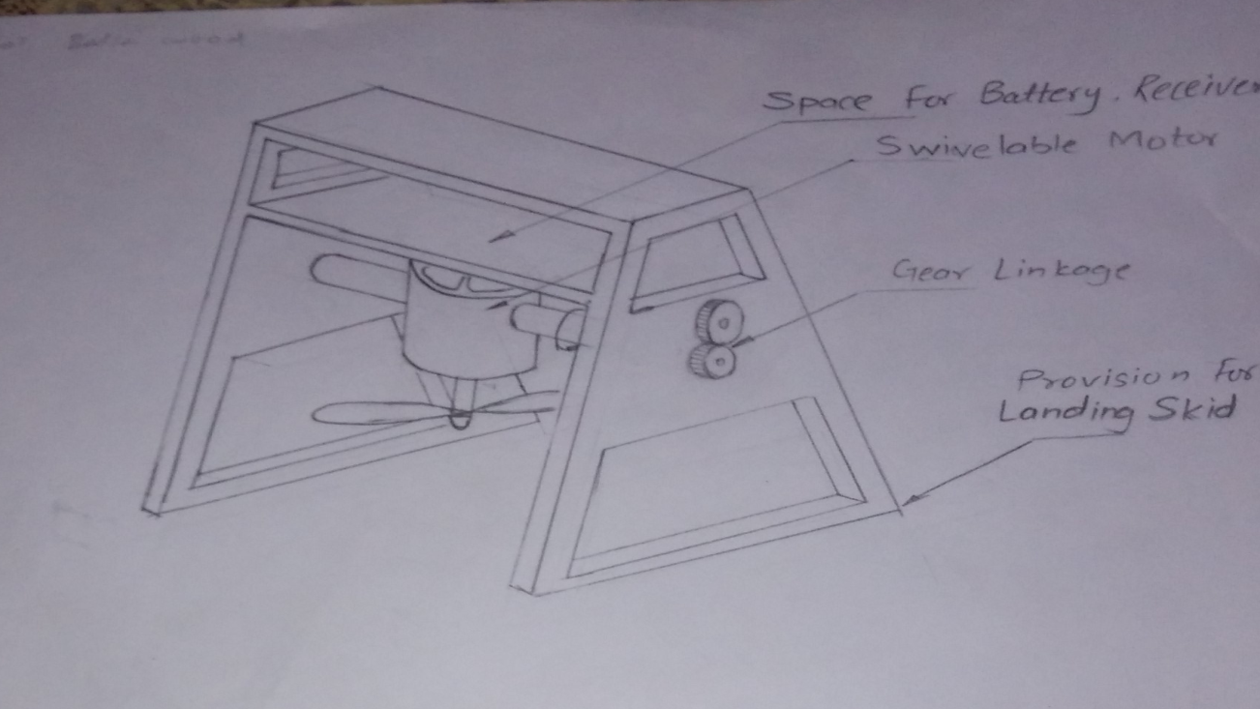
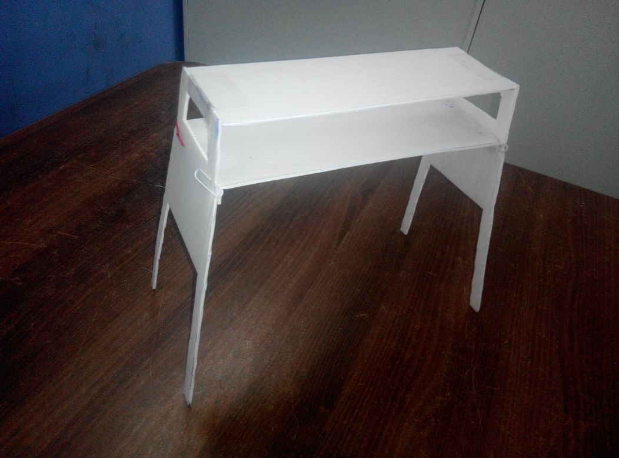
Design of Gondola (Fixed type)
Fig10: Design of gondola structure
Gondola prototype is made by plastic corrugated sheet as shown in fig 11
Fig11 : Gondola Prototype

Slide 17
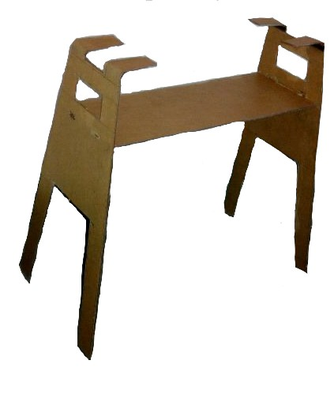
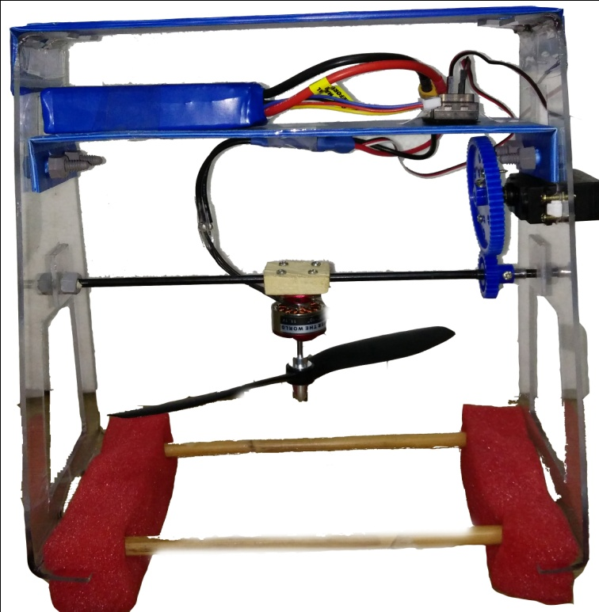
Fabricated Gondola
Gondola is made by 3mm thick sheet acrylic.
Its total weight is 170gm as shown in fig12
Fig 12 : Actual gondola
Upper Plate and middle plate is removed and replaced by PCS
Its total weight with avionics is 600gm as shown in fig13
Fig 13 : Gondola with avionics parts

Slide 18
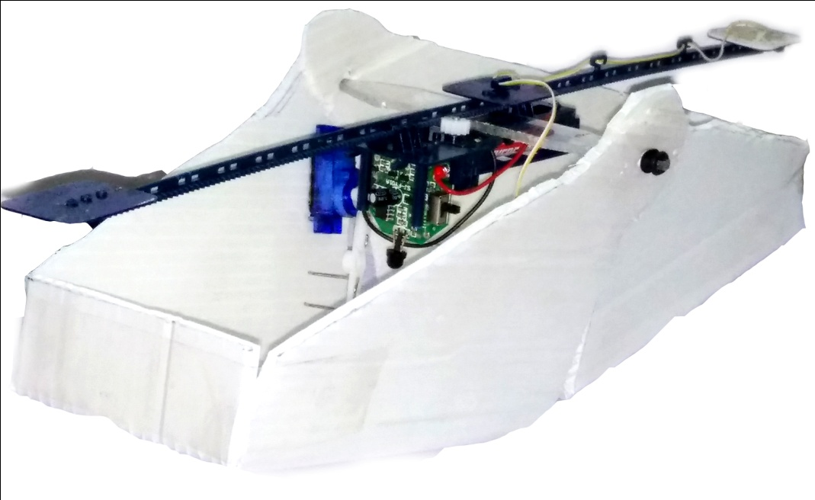
Sliding Gondola
Sliding mechanism will be attached with the envelope in order to pitch up and down of an airship.
Sliding gondola is also used as payload in order to drop items likes sparkles, chocolates and cards etc.
Fig 14 : Sliding gondola

Slide 19
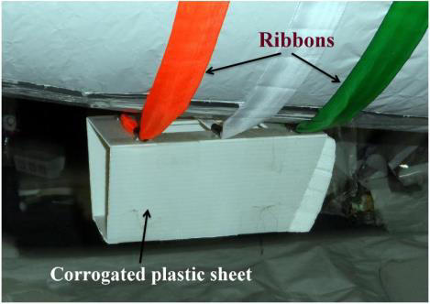
Attachment of gondola
Velcro strip
Ribbon attachment
Fig 13: indoor airship ^{[2]}
Fig 14: indoor airship ^{[3]}
Temporary
Removable
Light in weight
Temporary
Removable
Light in weight

Slide 20
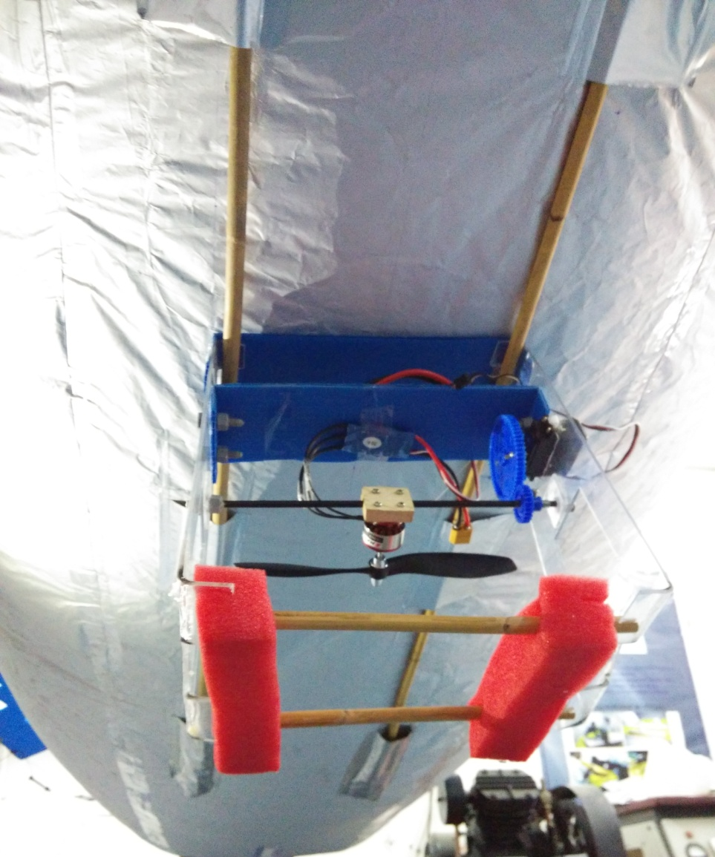
Attachment of gondola
Gondola will be attached on the wood part that will be fixed
with envelope through
patches.
Permanent
Rigid support
Strong
Fig15 : Fixed attachment

Slide 21
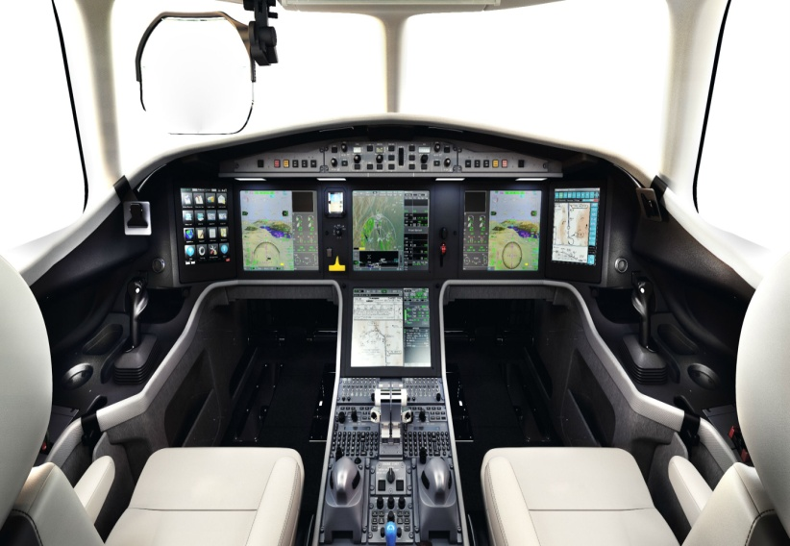
Avionics
Avionics system includes communications, navigation, the display and management of multiple systems etc.
In indoor airship this will consists of battery, remote controls and motors.
Fig 16: Avionic of airship ^{[4]}

Slide 22
Selection Of Motor Thrust motor is selected on the basis of drag experienced by the airship hull

Slide 23
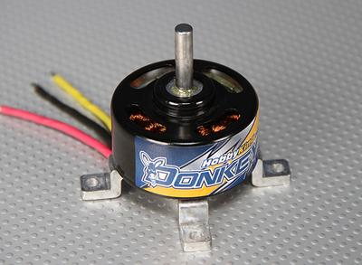
Avionics
Parameter | Main motor | Yaw motor
Name | FC 2822 Brushless Outrunner 1534kv | HobbyKing DonkeyST20004-1500Kv
Weight(gm) | 39 | 33
RPM(/v) & Current(A) | 1200 & 0.5 | 1500 & 0.3
Prop & Thrust | 7*6 & 700gm | 7*4 & 370gm
Picture

Slide 24
Selection of servo motor Servo motor is selected on the basis of torque required to rotate shaft

Slide 25
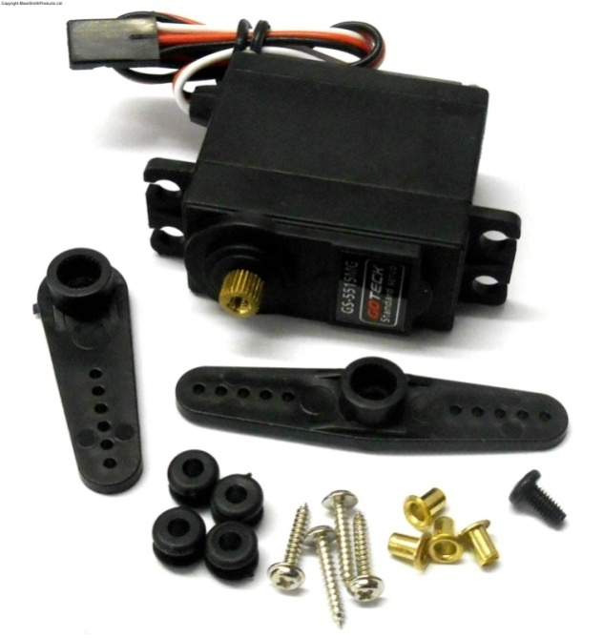
Servo motor
Parameters | Value At 4.8V | Value At 6V
Weight | 55 | 55
Standing Torque | 13 kg.cm | 15 kg.cm
Speed | 0.31 sec/60 deg at no load | 0.28 sec/60 deg at no load
Idle current | 250mA at stopped | 300mA at stopped
Running current | 2000mA at no load | 2200mA at no load
Operation travel | 60°±10° | 60°±10°
Fig 16: Servo Motor

Slide 26
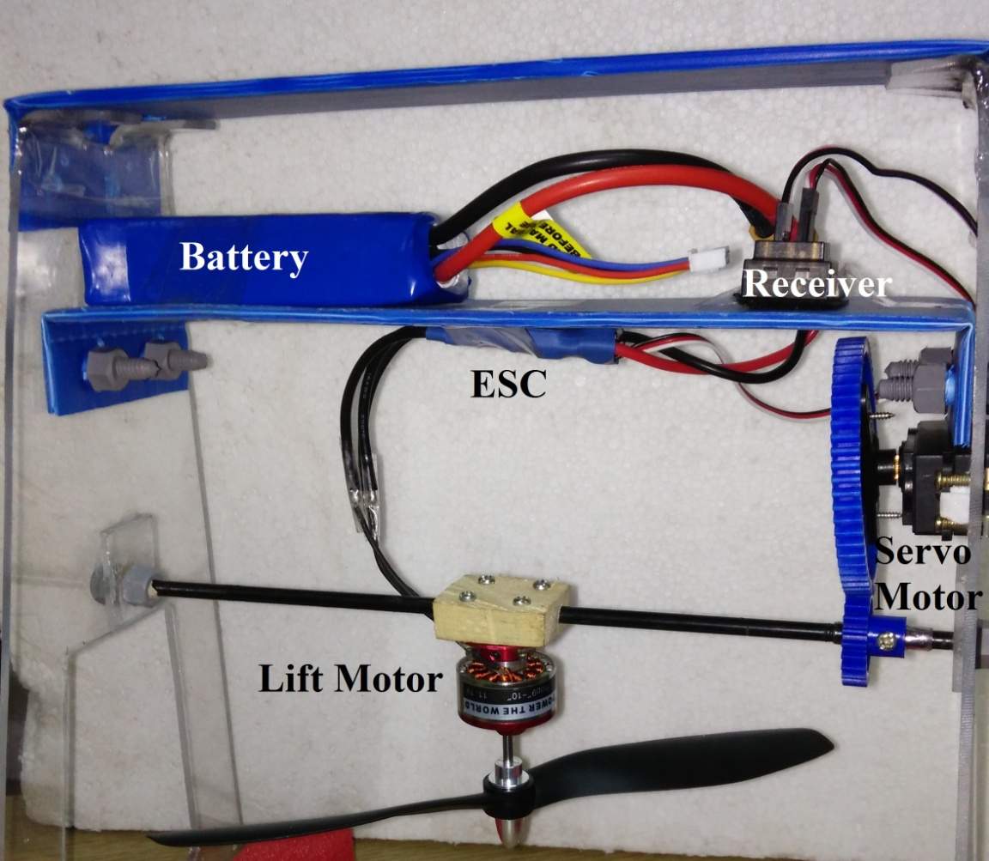
Avionics
Fig17 : Gondola with avionics

Slide 27
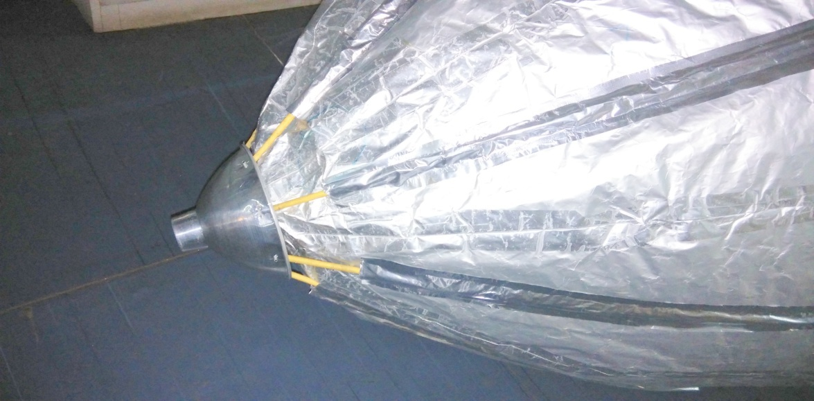
Nose Battens
Nose batten helps to make nose as an aerodynamic shape, and prevent from pushing as airship moves forward.
Mooring hooks are located in the nose of the airship.
Fig18 : Nose Batten

Slide 28
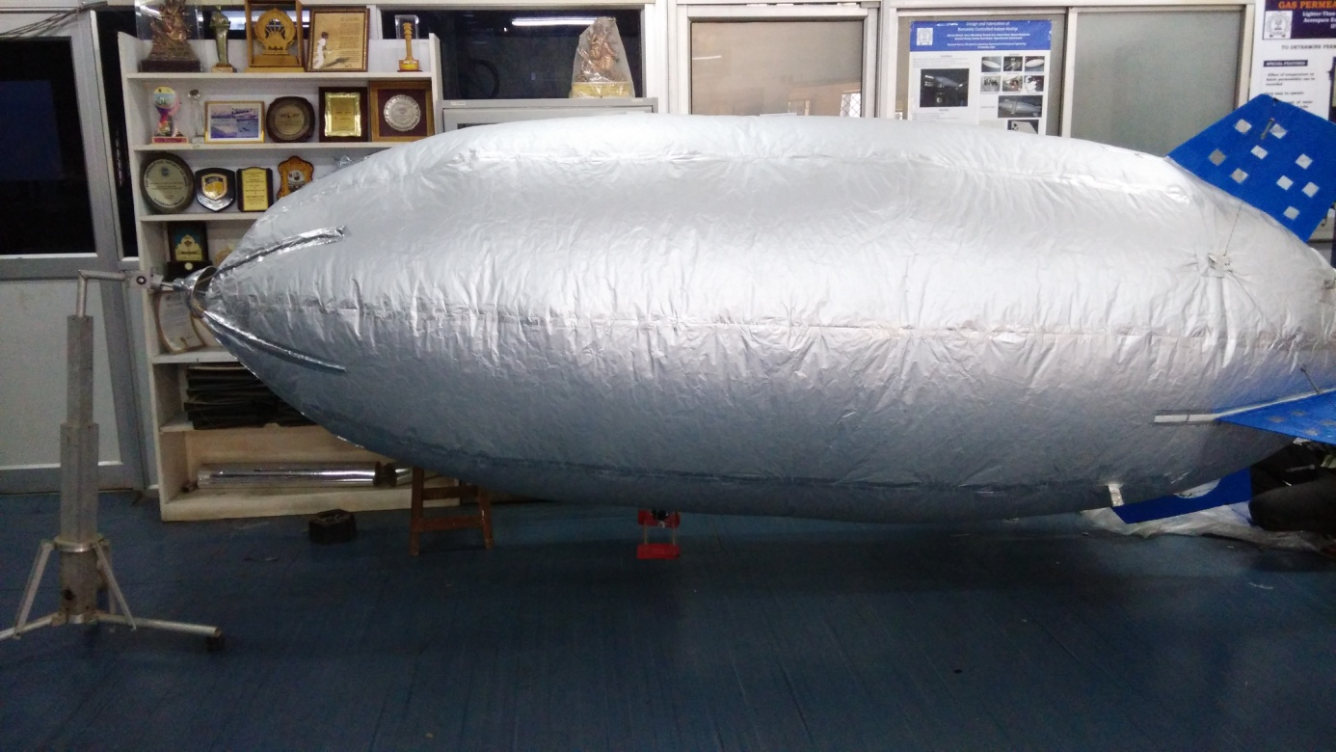
Mooring Mast
Mooring mast is a tower that contains a fitting on the top that allows nose of the airship to attach mooring line to the structure.
Fig19 : airship attached with Mooring Mast

Slide 29
Result
Parameters | Specification
Length[m] | 3.7
Diameter[m] | 1.3
Volume [m3] | 3.670
Surface Area [m2] | 13.037
Gross Lift [Kg] | 3.90
Net Lift [Kg] | 2.794
Fin Configuration | '+'type
Gondola Type | Open Structure

Slide 30
Flight Testing

Slide 31
Conclusion
A scaled model of an airship is fabricated in order to check permeability of material and the other parameters after successful testing and presentation of scale model finally the remotely controlled indoor airship( zeppelin shape) is designed fabricated and tested in IIT-Bombay. The new concept of sliding gondola along with fixed gondola has been designed and tested successfully. The result obtained by the methodology adopted for designed and fabrication found to be corrected. Design and fabrication of an airship is not as simple as it looks like.

Slide 32
References
Airship technology by GABRIEL ALEXANDER KHOURY pg no. 152, 170, 180
DESIGN AND FABRICATION OF A REMOTELY CONTROLLED AIRSHIP P.V.G.’S COLLEGE OF ENGINEERING AND TECHNOLOGY PUNE
“Design Fabrication and Flight Testing of a Non-rigid Indoor Airship” Gourav Bansal*, Utsav Bhardwaj*, Nischal Jain*, Sanyam S. Mulay†, Suchay Sawardekar*, Rajkumar S. Pant‡ IIT Bombay, Mumbai-76
Chaugule, V, Jahagirdar, Y. P., and Pant, R. S., “Remotely Controlled Airship for Aerial Surveillance: From Concept to Reality in under a month”, AIAA-2011-6916, Proceedings of 11th Aviation Technology, Integration, and Operations (ATIO) Conference and 19th Lighter-Than-Air (LTA) Technology Conference, 20-22 Sep. 2011, Virginia Beach, Norfolk, Virginia, USA
“Twin-Hull URRG Blimp Control for Low Altitude Surveillance Application” Guan Yap Tan, Mohd Rizal Arshad, and Herdawatie Abdul Kadir IRAM 2012, CCIS 330, pp. 176–182, 2012.
Nawaz I. Motiwala, Irshad Ahmed Khan, Nitesh P.Yelve, Balkrisha E. Narkhede, Rajkumar S. Pant “ Conceptual approach for Design, Fabrication and Testing of Indoor remotely controlled Airship”, Journal of Advance Material Research Vols 690-693 (2013) pp 3390- 3395

Slide 33
References
Web link: http://en.wikipedia.org/wiki/Airship
Web link: http://www.goodyear.eu/uk_en/news/goodyear-blimp/blimp-facts.jsp
Web link: http://www.deviantart.com/morelikethis/artists/430286156?view_mode=2
Web Link: http://www.goodyear.eu/uk_en/news/goodyear-blimp/blimp-facts.jsp
Web Link : http://oskbes.ru/au30-e.html
Web Link http://www.vrguild.net/website/Michigan/Grosse_Ile/Airship_Freedom/
Web Link: http://www.reddit.com/r/aviation/comments/1oyqo0/
Web Link: http://nbnl.globalwhelming.com/wp-content/uploads/2008/07/airship-2.jpg
Web Link: fineartamerica.com
Web Link: Ref: www.flickriver.com

