Slide 1

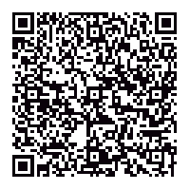
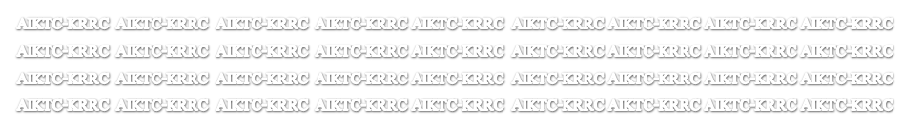
ANJUMAN-I-ISLAM’S
KALSEKAR TECHNICAL CAMPUS,
NEW PANVEL
Best Practices @ KRRC
Mrs. Shaheen Momin, Librarian
Knowledge Resources & Relay Centre (Central Library)
“Application of QR Code in Libraries & Hands on Training”
Ramniranjan Jhunjhunwala College, Ghatkopar
28th Dec., 2017

Slide 2
AIMS OF THE EVENT
To look at what QR codes
To show you how to scan them and how you can create them
To show you ways you could use them in academic libraries

Slide 3


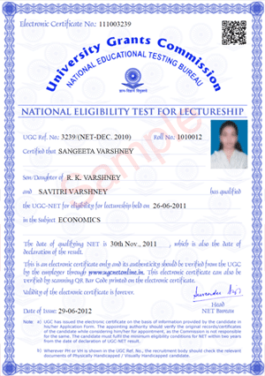
DAILY LIFE EXAMPLES

Slide 4
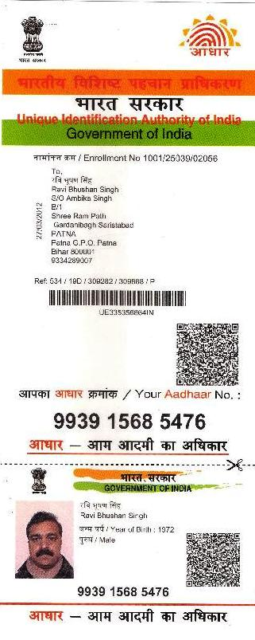
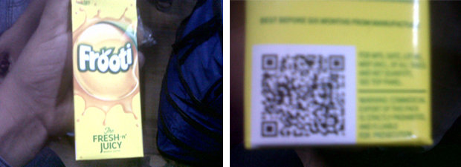
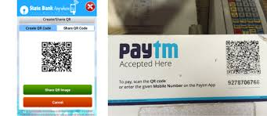
DAILY LIFE EXAMPLES

Slide 5
QR CODE vs BARCODE

Slide 6
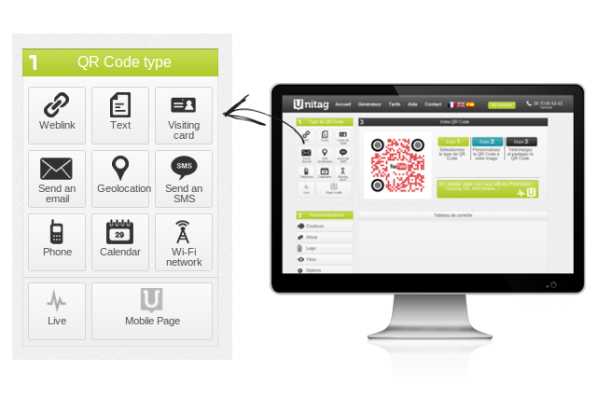
QR - SCAN RESULTS

Slide 7
BUSINESS CARD/CONTACT INFO
With these business card QR Codes, a contact card with the details you entered will be automatically stored into the contact list of the smartphone. You can enter your names, address, phone number, email and so on.

Slide 8
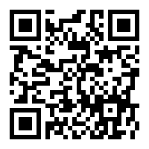
URL/WEBSITES
By scanning this type of QR Codes, users will be directed to a webpage and will discover the content available. This is the most common QR Code type.

Slide 9
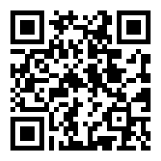
TEXT MESSAGE
This is the simplest QR Code type. A raw text is encoded and will be displayed on the screen after scanning. You can write anything you like.

Slide 10
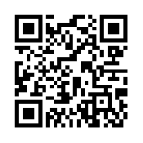
WIFI
You can create QR Codes that contain wireless network credentials. After scanning, smartphones will connect automatically!

Slide 11
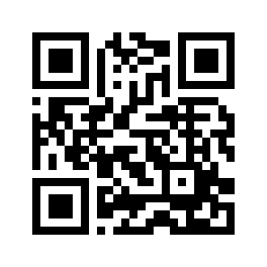
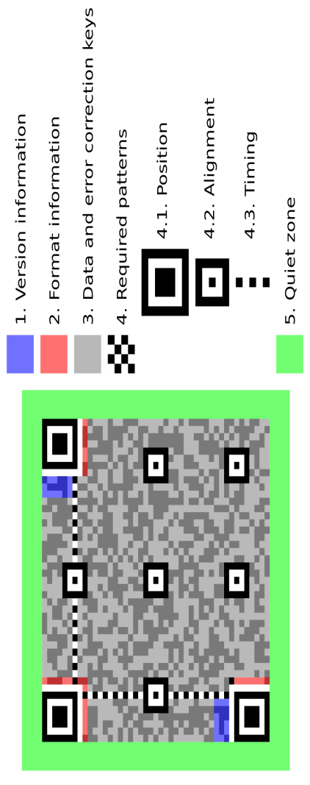
Quick Response (QR) Service
These little black and white squares have appeared everywhere from billboards at the side of road, roof tops, buses & magazines etc. So why not in your library, tbks., project or classroom display? The ability to use them to direct students to online resources is powerful and engaging and , when well implemented, can offer a level of interaction & engagement. It’s not about what they are but about how we use them in education setting.
Using computers & technology in educational environments can be exciting and challenging. Implementing QR Codes within your students learning is just that.
Through this workshop not only will you find eg. Of how QR Codes have been used but you will find out how you can design, create and implement your own QR Code.

Slide 12
Quick Response (QR) Service
QR stands for Quick Response Code
Invented in 1994 by the Toyota Motors subsidiary Denso Wave to track vehicles and parts during the manufacturing process
It is a two dimensional barcode, typically seen as a white square with black geometric shapes
It is basically a type of barcode which is readable by any camera-enabled smart phone

Slide 13
Quick Response (QR) Service
The main advantage of a QR code is its versatility. They can be used for anything and everything.
Free, can embed many types of media, easy to use.
Does not require understanding of writing code.
A fun and effective way of delivering enhanced information directly and conveniently to users.
Can track how many times the QR code is scanned for statistical purposes.

Slide 14
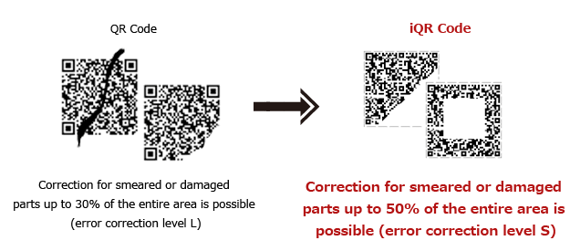
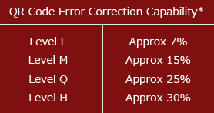
QR Code Significant
Data Restoration:-Occasionally QR codes and bar codes become damaged or they may get dirty. Barcode reader will not be able to scan a damaged or dirty code whereas up to 30% of code words in a QR code can be restored depending upon amount of damage.

Slide 15
QR Code Significant
Expert in Scan Position and Speed:-Barcode must be scanned in the correct position. But QR code can be scanned from any position. This is due to the three position detection patterns located in three corner of the code. The reader will locate these three detection patterns and know how to correctly read the code. This feature speeds up the time needed to scan objects.

Slide 16
QR Code Downside
Lack of Awareness: One disadvantage of QR codes and perhaps the biggest problem is the lack of familiarity of the QR code among people.
Expensive Smartphone and apps required: User needs to have a smartphone in order to use one. Along with the smartphone they also need a QR code reader application, not everyone in the world own a smart phone so QR code not available to everyone.
QR code not default provided: QR code reader are not preinstalled on most phones. it is installed by user.

Slide 17
QR Code Tools
Four things are required in order to successfully decode a QR code:
QR code Generator
Smartphone, Desktop (with a camera),
QR code Scanning Software application, and
Internet Connection (either through the phone’s data plan or over a site-generated wireless network).

Slide 18
QR Code Software
There are plenty of free QR code generators websites. Some websites are:
KAYWA Generator - http://qrcode.kaywa.com/
QR Generator - https://www.the-qrcode-generator.com/
Go QR Generator - http://goqr.me/
QR Stuff Generator - http://www.qrstuff.com/
Bee Tag QR Generator - http://www.beetagg.com/

Slide 19
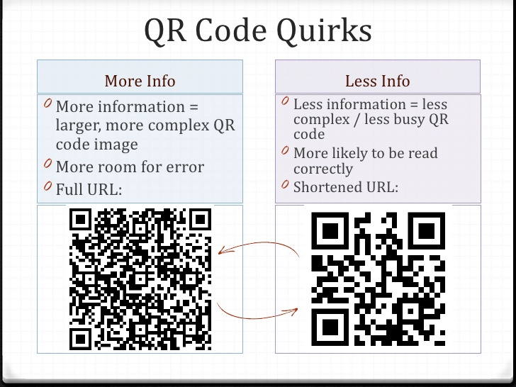
TIPS

Slide 20
QR Service @ KRRC
Library had created QR Codes that contain Wi-Fi network credentials pasted within the library. After scanning user will connect to internet connection.
Library uses QR Codes on end stacks to lead users to the WebOPAC. After scanning user will be redirect to WebOPAC.
Library had created QR Codes that contain links of materials stored in the Institutional Repository of AIKTC developed by using Dspace. (Question Papers, Syllabus, CD Contents. Project Reports etc.)
Most of the publishers provides the web supplements for instructors and students.

Slide 21
QR Service @ KRRC
Library uses QR Codes for New Arrival list. After scanning user will be redirect to links given at the website.
Library had Articles Abstract Database of subscribed print journals. After scanning the QR code paste on print journals user will be redirect for achieves.
CDs/DVDs content upload on the Institutional Repository for easy access & future preservation.

Slide 22

Disclaimer
Disclaimer (Images)
The images used in this presentation are found from different sources all over the Internet, and are assumed to be in public domain and are displayed under the fair use principle for education purpose.
Copyright @ Presentation
The said presentation is copyright under Copyright @ shaheenmomin2017
The presentation is for education purpose only, don’t use the same for any legal perspective.

Slide 23


